Slide 1
Requirements Analysis and Specification (Lecture 3)

Slide 2
Organization of this Lecture
Introduction
Requirements analysis
Requirements specification
SRS document
Decision table
Decision tree
Summary

Slide 3
Requirements Analysis and Specification
Many projects fail:
  Because they start implementing the system.
  Without determining whether they are building what the customer really wants.

Slide 4
Requirements Analysis and Specification
It is important to learn:
  Requirements analysis and specification techniques carefully.

Slide 5
Requirements Analysis and Specification
Goals of requirements analysis and specification phase:
  Fully understand the user requirements.
  Remove inconsistencies, anomalies, etc. from requirements.
  Document requirements properly in an SRS document.

Slide 6
Requirements Analysis and Specification
Consists of two distinct activities:
    Requirements Gathering and Analysis
    Specification

Slide 7
Who Carries Out Requirements Analysis and Specification?
The person who undertakes requirements analysis and specification:
  Known as systems analyst:
  Collects data pertaining to the product
  Analyzes collected data:
    To understand what exactly needs to be done.
  Writes the Software Requirements Specification (SRS) document.

Slide 8
Requirements Analysis and Specification
Final output of this phase:
  Software Requirements Specification (SRS) Document.
The SRS document is reviewed by the customer.
  Reviewed SRS document forms the basis of all future development activities.

Slide 9
Requirements Analysis
Requirements analysis consists of two main activities:
  Requirements gathering
  Analysis of the gathered requirements

Slide 10
Requirements Analysis
Analyst gathers requirements through:
  Observation of existing systems,
  Studying existing procedures,
  Discussion with the customer and end-users,
  Analysis of what needs to be done, etc.

Slide 11
Requirements Gathering
Also known as requirements elicitation.
If the project is to automate some existing procedures
  e.g., automating existing manual accounting activities,
  The task of the system analyst is a little easier
  Analyst can immediately obtain:
    input and output formats
    accurate details of the operational procedures

Slide 12
Requirements Gathering Activities
1. Studying the existing documentation
2. Interview
3. Task analysis
4. Scenario analysis
5. Form analysis

Slide 13
Requirements Gathering (CONT.)
In the absence of a working system,
  Lot of imagination and creativity are required.
Interacting with the customer to gather relevant data:
  Requires a lot of experience.

Slide 14
Requirements Gathering (CONT.)
Some desirable attributes of a good system analyst:
  Good interaction skills,
  Imagination and creativity,
  Experience.

Slide 15
Case Study: Automation of Office Work at CSE Dept.
The academic, inventory, and financial information at the CSE department:
  Being carried though manual processing by two office clerks, a store keeper, and two attendants.
Considering the low budget he had at his
Disposal:
  The HoD entrusted the work to a team of student volunteers.

Slide 16
Case Study: Automation of Office Work at CSE Dept.
The team was first briefed by the HoD about the specific activities to be automated.
The analyst first discussed with the two clerks:
  Regarding their specific responsibilities (tasks) that were to be automated.
The analyst also interviewed student and faculty representatives who would also use the software.

Slide 17
Case Study: Automation of Office Work at CSE Dept.
For each task, they asked:
  About the steps through which these are performed.
  They also discussed various scenarios that might arise for each task.
  The analyst collected all types of forms that were being used.

Slide 18
Analysis of the Gathered Requirements
Main purpose of requirements analysis:
    Clearly understand the user requirements,
    Detect inconsistencies, ambiguities, and incompleteness.
Incompleteness and inconsistencies:
  Resolved through further discussions with the end-users and the customers.

Slide 19
Inconsistent Requirement
Some part of the requirement:
  contradicts with some other part.
Example:
  One customer says turn off heater and open water shower when temperature > 100 C
  Another customer says turn off heater and turn ON cooler when temperature > 100 C

Slide 20
Incomplete Requirement
Some requirements have been omitted:
  Possibly due to oversight.
Example:
  The analyst has not recorded:
  when temperature falls below 90 C
    heater should be turned ON
    water shower turned OFF.

Slide 21
Analysis of the Gathered Requirements (CONT.)
Requirements analysis involves:
  Obtaining a clear, in-depth understanding of the product to be developed,
  Remove all ambiguities and inconsistencies from the initial customer perception of the problem.

Slide 22
Analysis of the Gathered Requirements (CONT.)
It is quite difficult to obtain:
  A clear, in-depth understanding of the problem:
    Especially if there is no working model of the problem.

Slide 23
Analysis of the Gathered Requirements (CONT.)
Experienced analysts take considerable time:
  To understand the exact requirements the customer has in his mind.

Slide 24
Analysis of the Gathered Requirements (CONT.)
Experienced systems analysts know -
often as a result of painful experiences ---
  Without a clear understanding of the problem, it is impossible to develop a satisfactory system.

Slide 25
Analysis of the Gathered Requirements(CONT.)
Several things about the project should be clearly understood by the analyst:
  What is the problem?
  Why is it important to solve the problem?
  What are the possible solutions to the problem?
  What complexities might arise while solving the problem?

Slide 26
Analysis of the Gathered Requirements(CONT.)
Some anomalies and inconsistencies can be very subtle:
  Escape even most experienced eyes.
  If a formal model of the system is constructed,
    Many of the subtle anomalies and inconsistencies get detected.

Slide 27
Analysis of the Gathered Requirements(CONT.)
After collecting all data regarding the system to be developed,
  Remove all inconsistencies and anomalies from the requirements,
  Systematically organize requirements into a Software Requirements Specification (SRS) document.

Slide 28
Software Requirements Specification
Main aim of requirements specification:
  Systematically organize the requirements arrived during requirements analysis.
  Document requirements properly.

Slide 29
Software Requirements Specification
The SRS document is useful in various contexts:
  Statement of user needs
  Contract document
  Reference document
  Definition for implementation

Slide 30
Software Requirements Specification: A Contract Document
Requirements document is a reference document.
SRS document is a contract between the development team and the customer.
  Once the SRS document is approved by the customer,
    Any subsequent controversies are settled by referring the SRS document.

Slide 31
Software Requirements Specification: A Contract Document
Once customer agrees to the SRS document:
  Development team starts to develop the product according to the requirements recorded in the SRS document.
The final product will be acceptable to the customer:
  As long as it satisfies all the requirements recorded in the SRS document.

Slide 32
SRS Document (CONT.)
The SRS document is known as black-box specification:
  The system is considered as a black box whose internal details are not known.
  Only its visible external (i.e. input/output) behavior is documented.
S
Output Data
Input Data

Slide 33
SRS Document (CONT.)
SRS document concentrates on:
  What needs to be done
  Carefully avoids the solution (“how to do”) aspects.
The SRS document serves as a contract
  Between development team and the customer.
  Should be carefully written

Slide 34
SRS Document (CONT.)
The requirements at this stage:
  Written using end-user terminology.
If necessary:
  Later a formal requirement specification may be developed from it.

Slide 35
Properties of a Good SRS Document
It should be concise
  and at the same time should not be ambiguous.
It should specify what the system must do
  and not say how to do it.
Easy to change.,
  i.e. it should be well-structured.
It should be consistent.
It should be complete.

Slide 36
Properties of a Good SRS Document (cont...)
It should be traceable
  You should be able to trace which part of the specification corresponds to which part of the design, code, etc and vice versa.
It should be verifiable
  e.g. “system should be user friendly” is not verifiable

Slide 37
SRS Document (CONT.)
SRS document, normally contains three important parts:
  Functional requirements,
  Non-functional requirements,
  Goals of Implementation.

Slide 38
SRS Document (CONT.)
It is desirable to consider every system:
  Performing a set of functions {fi}.
  Each function fi considered as:
  Transforming a set of input data to corresponding output data.
Input Data
Output Data
fi

Slide 39
Example: Functional Requirement
F1: Search Book
  Input:
    an author’s name:
  Output:
    details of the author’s books and the locations of these books in the library.
Author Name
Book Details
f1

Slide 40
Functional Requirements
Functional requirements describe:
  A set of high-level requirements
  Each high-level requirement:
    takes in some data from the user
    outputs some data to the user
  Each high-level requirement:
    might consist of a set of identifiable functions

Slide 41
Functional Requirements
For each high-level requirement:
  Every function is described in terms of:
    Input data set
    Output data set
    Processing required to obtain the output data set from the input data set.

Slide 42
Nonfunctional Requirements
Characteristics of the system which can not be expressed as functions:
    Maintainability,
    Portability,
    Usability, etc.

Slide 43
Nonfunctional Requirements
Nonfunctional requirements include:
  Reliability issues,
  Performance issues:
    Example: How fast the system can produce results
      so that it does not overload another system to which it supplies data, etc.
  Human-computer interface issues,
  Interface with other external systems,
  Security, maintainability, etc.

Slide 44
Non-Functional Requirements
Hardware to be used,
Operating system
  or DBMS to be used
Capabilities of I/O devices
Standards compliance
Data representations
  by the interfaced system

Slide 45
Goals of Implementation
Goals describe things that are desirable of the system:
  But, would not be checked for compliance.
  For example,
    Reusability issues
    Functionalities to be developed in future

Slide 46
Organization of the SRS Document
Introduction.
Functional Requirements
Nonfunctional Requirements
  External interface requirements
  Performance requirements
Goals of implementation

Slide 47
Functional Requirements
A high-level function is one:
  Using which the user can get some useful piece of work done.
Can the receipt printing work during withdrawal of money from an ATM:
  Be called a useful piece of work?
A high-level requirement typically involves:
  Accepting some data from the user,
  Transforming it to the required response, and then
  Outputting the system response to the user.

Slide 48
High-Level Function
A high-level function:
  Usually involves a series of interactions between the system and one or more users.
Even for the same high-level function,
  There can be different interaction sequences (or scenarios)
  Due to users selecting different options or entering different data items.

Slide 49
Example Functional Requirements
List all functional requirements
  with proper numbering.
Req. 1:
  Once the user selects the “search” option,
    he is asked to enter the key words.
  The system should output details of all books
    whose title or author name matches any of the key words entered.
    Details include: Title, Author Name, Publisher name, Year of Publication, ISBN Number, Catalog Number, Location in the Library.

Slide 50
Example Functional Requirements
Req. 2:
  When the “renew” option is selected,
    The user is asked to enter his membership number and password.
  After password validation,
    The list of the books borrowed by him are displayed.
  The user can renew any of the books:
    By clicking in the corresponding renew box.

Slide 51
Req. 1:
R.1.1:
  Input: “search” option,
  Output: user prompted to enter the key words.
R1.2:
  Input: key words
  Output: Details of all books whose title or author name matches any of the key words.
    Details include: Title, Author Name, Publisher name, Year of Publication, ISBN Number, Catalog Number, Location in the Library.
  Processing: Search the book list for the keywords

Slide 52
Req. 2:
R2.1:
  Input: “renew” option selected,
  Output: user prompted to enter his membership number and password.
R2.2:
  Input: membership number and password
  Output:
    list of the books borrowed by user are displayed. User prompted to enter books to be renewed or
    user informed about bad password
  Processing: Password validation, search books issued to the user from borrower list and display.

Slide 53
Req. 2:
R2.3:
  Input: user choice for renewal of the books issued to him through mouse clicks in the corresponding renew box.
  Output: Confirmation of the books renewed
  Processing: Renew the books selected by the in the borrower list.

Slide 54
Examples of Bad SRS Documents
Unstructured Specifications:
  Narrative essay --- one of the worst types of specification document:
    Difficult to change,
    Difficult to be precise,
    Difficult to be unambiguous,
    Scope for contradictions, etc.

Slide 55
Examples of Bad SRS Documents
Noise:
  Presence of text containing information irrelevant to the problem.
Silence:
  aspects important to proper solution of the problem are omitted.

Slide 56
Examples of Bad SRS Documents
Overspecification:
  Addressing “how to” aspects
  For example, “Library member names should be stored in a sorted descending order”
  Overspecification restricts the solution space for the designer.
Contradictions:
  Contradictions might arise
    if the same thing described at several places in different ways.

Slide 57
Examples of Bad SRS Documents
Ambiguity:
  Literary expressions
  Unquantifiable aspects, e.g. “good user interface”
Forward References:
  References to aspects of problem
    defined only later on in the text.
Wishful Thinking:
  Descriptions of aspects
    for which realistic solutions will be hard to find.

Slide 58
Representation of complex processing logic:
Decision trees
Decision tables

Slide 59
Decision Trees
Decision trees:
A decision tree is a decision support tool that uses a tree-like graph or model of decisions and their possible consequences, including chance event outcomes, resource costs, and utility. It is one way to display an algorithm.
  Edges of a decision tree represent conditions.
  Leaf nodes represent actions to be performed.
A decision tree gives a graphic view of:
  Logic involved in decision making
  Corresponding actions taken.

Slide 60
Decision Trees
There are three broad areas usually displayed in a tree:
The Decision: displayed as a square node with two or more arcs (called “decision branches”) pointing to the options.
The Event sequence: displayed as a circle node with two or more arcs pointing out the events. Probabilities may be displayed with the circle nodes, which are sometimes called “chance nodes”.
The Consequences: the costs or utilities associated with different pathways of the decision tree. The endpoint is called a “Terminal” and is represented by a triangle or bar on a computer.

Slide 61
Decision Trees
Decision rules
The decision tree can be linearized into decision rules, where the outcome is the contents of the leaf node, and the conditions along the path form a conjunction in the if clause. In general, the rules have the form:
if condition1 and condition2 and condition3 then outcome.
Decision rules can be generated by constructing association rules with the target variable on the right. They can also denote temporal or causal relations.

Slide 62
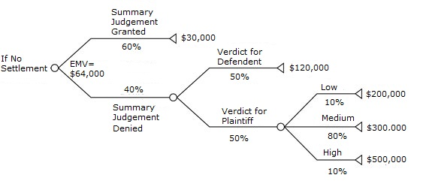
Decision Trees

Slide 63
Example: LMS
A Library Membership automation Software (LMS) should support the following three options:
  New member,
  Renewal,
  Cancel membership.

Slide 64
Example: LMS
When the new member option is selected,
  The software asks details about the member:
    name,
    address,
    phone number, etc.

Slide 65
Example(cont.)
If proper information is entered,
  A membership record for the member is created
  A bill is printed for the annual membership charge plus the security deposit payable.

Slide 66
Example(cont.)
If the renewal option is chosen,
  LMS asks the member's name and his membership number
    checks whether he is a valid member.
  If the name represents a valid member,
    the membership expiry date is updated and the annual membership bill is printed,
    otherwise an error message is displayed.

Slide 67
Example(cont.)
If the cancel membership option is selected and the name of a valid member is entered,
  The membership is cancelled,
  A cheque for the balance amount due to the member is printed
  The membership record is deleted.

Slide 68
Decision Tree
- Get details
- Create record
- Print bills
New member
- Get Details
Renewal
- Update record
YES
User input
- Print bills
Cancel
NO
- Get Details
- Print Cheque
Invalid option
- Delete record
- Print error message

Slide 69
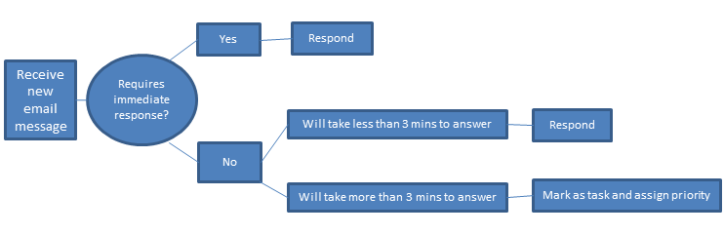
Example: An email management decision tree might begin with a box labeled “Receive new message.” From that, one branch leading off might lead to “Requires immediate response.” From there, a “Yes” box leads to a single decision: “Respond.” A “No” box leads to “Will take less than three minutes to answer” or “Will take more than three minutes to answer.” From the first box, a box leads to “Respond” and from the second box, a branch leads to “Mark as task and assign priority.” The branches might converge after that to “Email responded to? File or delete message.”

Slide 70
Advantages and Disadvantages
Advantages
A decision tree is easy to understand and interpret.
Expert opinion and preferences can be included, as well as hard data.
Can be used with other decision techniques.
New scenarios can easily be added.
Disadvantages
If a decision tree is used for categorical variables with multiple levels, those variables with more levels will have more information gain.
Calculations can quickly become very complex, although this is usually only a problem if the tree is being created by hand.

Slide 71
Decision Table
What is a decision table ?
Decision tables are compact and precise ways of modelling complicated logic, that which you might use in a computer program. They do this by mapping the different states of a program to an action that a program should perform.
    Table representing complete set of conditional expressions.
    where expressions are mutually exclusive
    in a predefined area
Decision tables take on the following format:
The four quadrants
Conditions | Condition alternatives
Actions | Action entries

Slide 72
Decision Table
A decision table shows in a tabular form:
  Processing logic and corresponding actions
Upper rows of the table specify:
  The variables or conditions to be evaluated
Lower rows specify:
  The actions to be taken when the corresponding conditions are satisfied.

Slide 73
Decision Table
In technical terminology,
  a column of the table is called a rule:
  A rule implies:
    if a condition is true, then execute the corresponding action.

Slide 74
Decision Table
Decision tables specify:
  Which variables are to be tested
  What actions are to be taken if the conditions are true,
  The order in which decision making is performed.

Slide 75
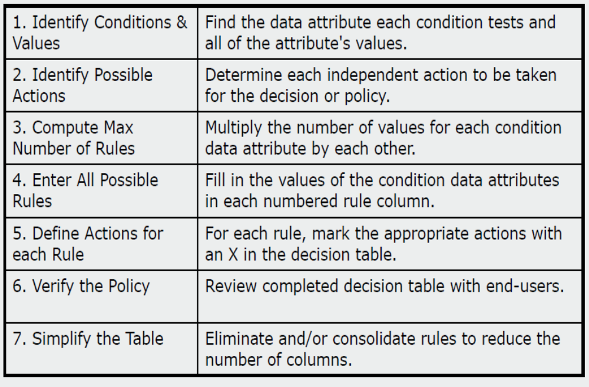
Decision Table Methodology

Slide 76
Example (LMS):
Decision Table
The limited-entry decision table is the simplest to describe.
The condition alternatives are simple Boolean values, and the action entries are check-marks, representing which of the actions in a given column are to be performed.
Conditions | R1 | R2 | R3 | R4 | R5
Valid selection | -- | NO | YES | YES | YES
New member | -- | YES | NO | NO | --
Renewal | -- | NO | YES | NO | --
Cancellation | -- | NO | NO | YES | --
Actions
Display error message | *
Ask member's name etc. |  | *
Build customer record |  | *
Generate bill |  | * | *
Ask membership details |  |  | * | *
Update expiry date |  |  | *
Print cheque |  |  |  | *
Delete record |  |  |  | *

Slide 77
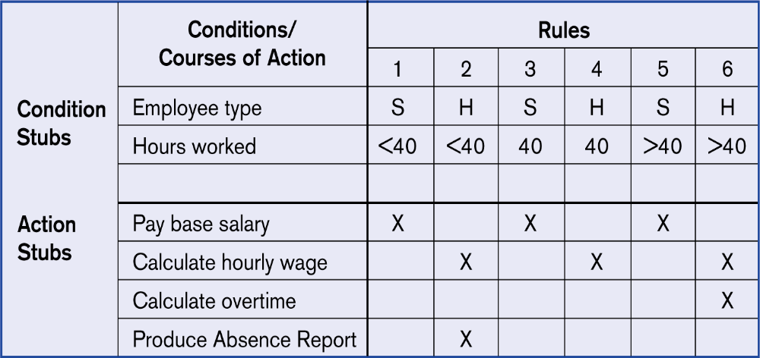
Example decision table

Slide 78
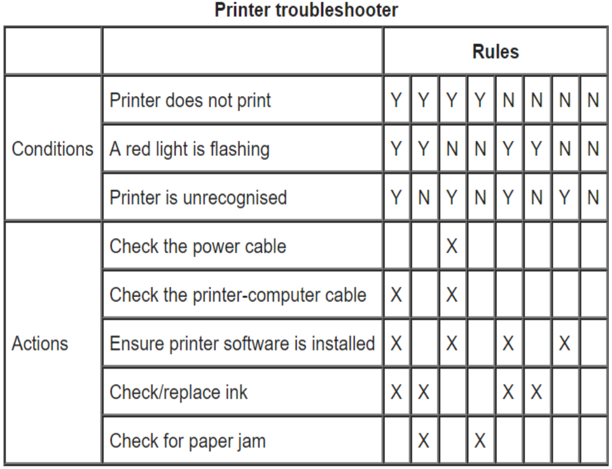
Example decision table
A technical support company writes a decision table to diagnose printer problems based upon symptoms described to them over the phone from their clients. They type the following data into the advice program:
  Printer does print
  Red light is flashing
  Printer is recognised
The program then uses the decision table to find the correct actions to perform, namely that of Check / Replace ink.

Slide 79
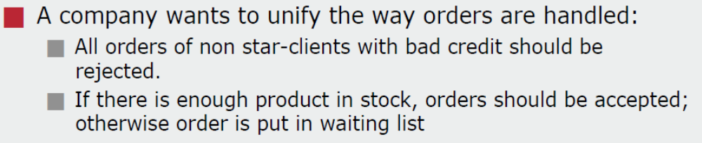
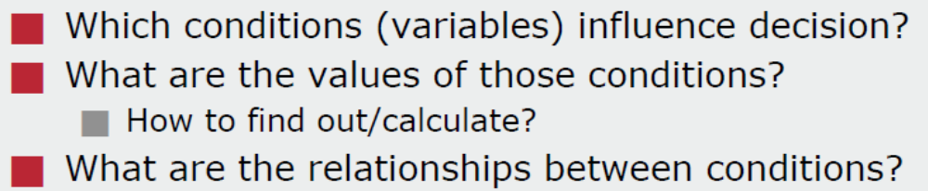
Scenario
Decision diagram

Slide 80
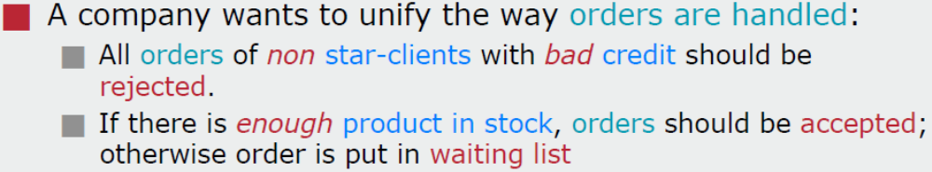
Scenario: conditions and actions

Slide 81
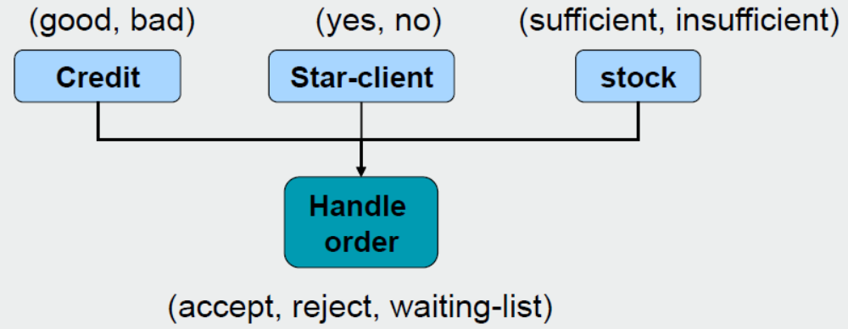
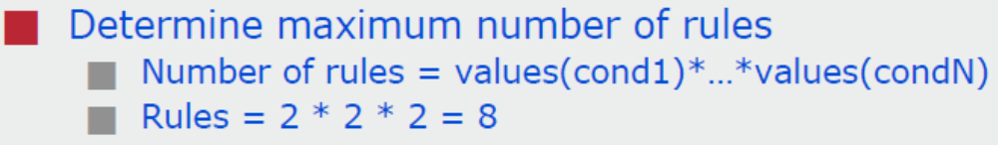
Decision diagram example
Conditions:
Actions:

Slide 82
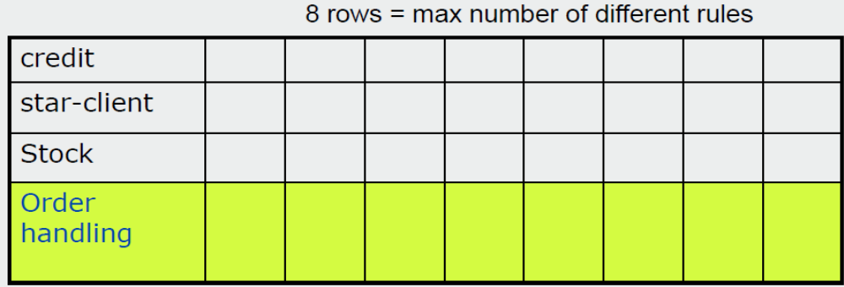
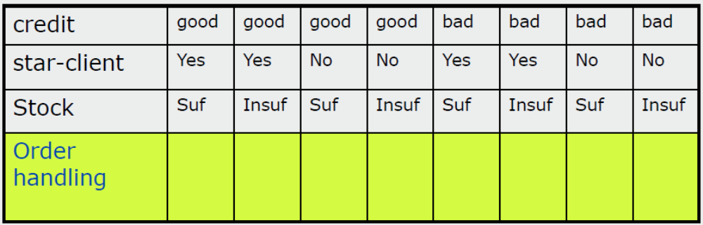
Decision table

Slide 83
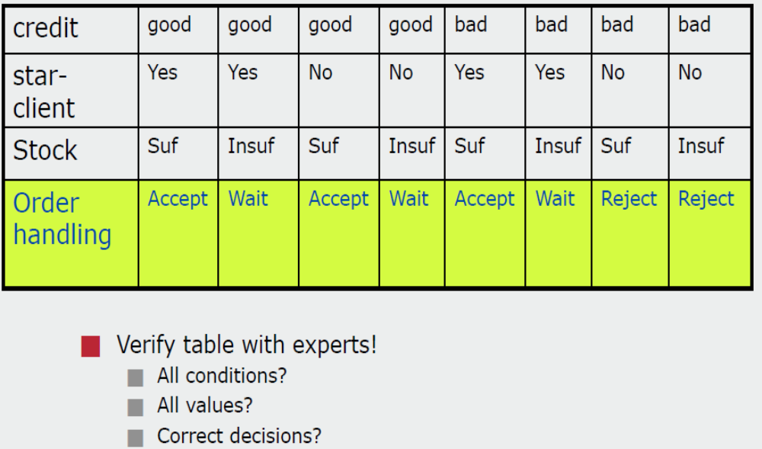
Decision table

Slide 84
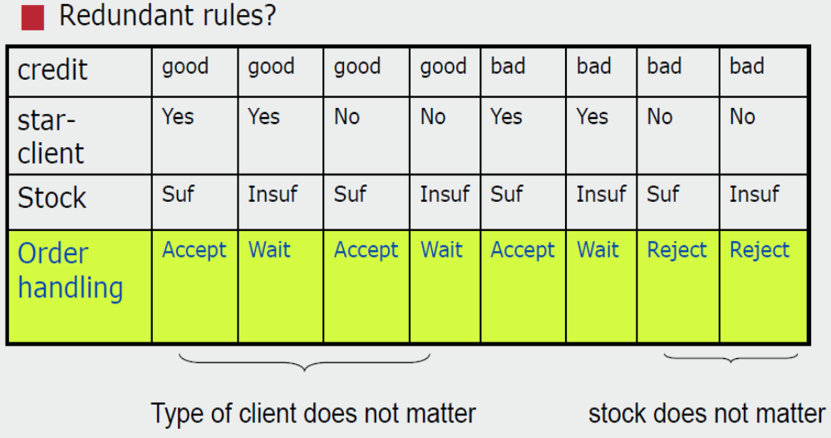
Simplification

Slide 85
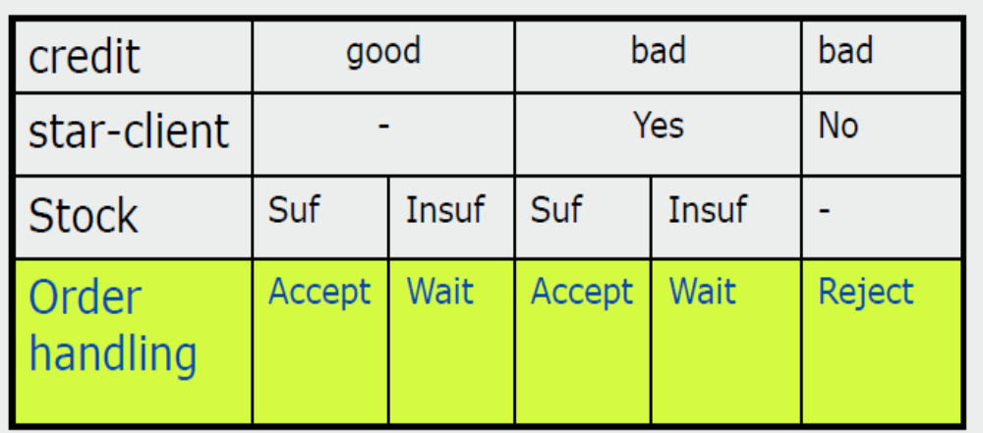
Decision table simplified

Slide 86
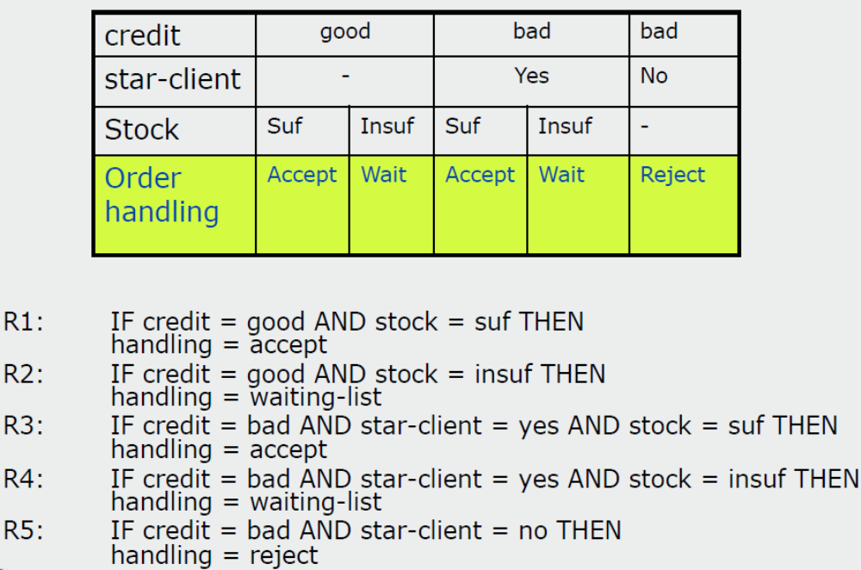
From decision tables to rules

Slide 87
Comparison
Both decision tables and decision trees
  Can represent complex program logic.
Decision trees are easier to read and understand
  When the number of conditions are small.
Decision tables help to look at every possible combination of conditions.

Slide 88
Exercise: Decision Tables
Create a decision table for the following program in an office email system;
  Send email when Recipient address present, subject present, before 5:30pm
  If after 5:30pm then put in pending folder
  If Recipient address missing or subject message, give warning message

Slide 89
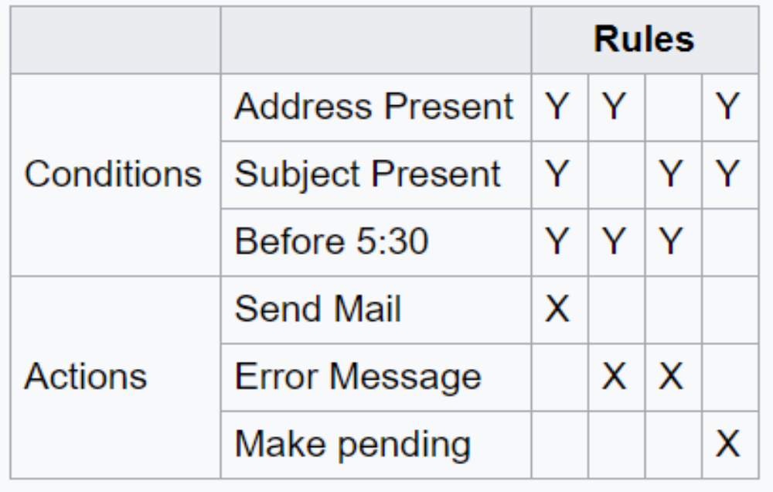
This question is open to interpretation, but you should have something resembling this:

Slide 90
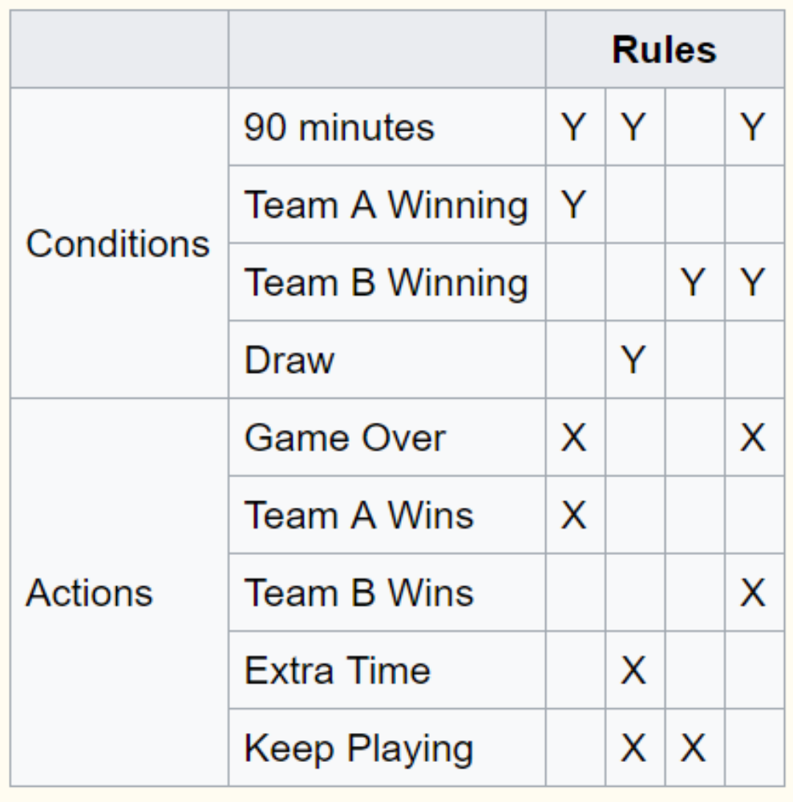
Example: Decision Tables
Let's take a look at a computer game example, for a football simulation the following rules are set up.
What happens when:
90 minutes up
the game is a draw
Ans: Keep Playing and give them some extra time

Slide 91
Formal Specification
A formal specification technique is a mathematical method to:
  Accurately specify a system.
  Verify that implementation satisfies specification.
  Prove properties of the specification.

Slide 92
Formal Specification
Advantages:
  Well-defined semantics, no scope for ambiguity
  Automated tools can check properties of specifications
  Executable specification

Slide 93
Formal Specification
Disadvantages of formal specification techniques:
  Difficult to learn and use
  Not able to handle complex systems

Slide 94
Formal Specification
Mathematical techniques used include:
  Logic-based
  set theoretic
  algebraic specification
  finite state machines, etc.

Slide 95
Semiformal Specification
Structured specification languages
  SADT (Structured Analysis and Design Technique)
  PSL/PSA (Problem Statement Language/Problem Statement Analyzer)
    PSL is a semi-formal specification language
    PSA can analyze the specifications expressed in PSL

Slide 96
Executable Specification Language
If specification is expressed in formal language:
  it becomes possible to execute the specification to provide a system prototype.
However, executable specifications are usually slow and inefficient.

Slide 97
Executable Specification Language
Executable specifications only test functional requirements:
  If non-functional requirements are important for some product,
    The utility of an executable specification prototype is limited.

Slide 98
4GLs
4GLs (Fourth Generation Languages) are examples of
  executable specification languages.
4GLs are successful
  because there is a lot of commonality across data processing applications.

Slide 99
4GLs
4GLs rely on software reuse
  Where common abstractions have been identified and parameterized.
Rewriting 4GL programs in higher level languages:
  Result in upto 50% lower memory requirements
  Also the programs run upto 10 times faster.

Slide 100
Summary
Requirements analysis and specification
  An important phase of software development:
  Any error in this phase would affect all subsequent phases of development.
Consists of two different activities:
  Requirements gathering and analysis
  Requirements specification

Slide 101
Summary
The aims of requirements analysis:
  Gather all user requirements
  Clearly understand exact user requirements
  Remove inconsistencies and incompleteness.
The goal of specification:
  Systematically organize requirements
  Document the requirements in an SRS document.

Slide 102
Summary
Main components of SRS document:
  Functional requirements
  Non-functional requirements
  Constraints
Techniques to express complex logic:
  Decision tree
  Decision table

Slide 103
Summary
Formal requirements specifications have several advantages.
  But the major shortcoming is that these are hard to use.

